Slide 1
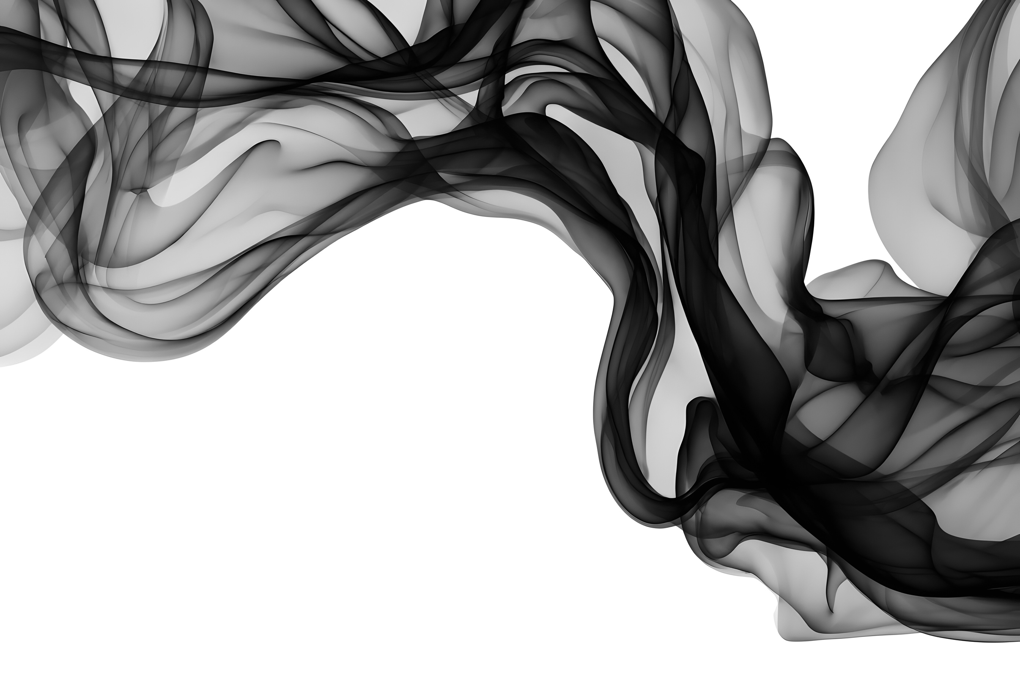

THE BASICS OF INK,
PH & VISCOSITY
JAKE WANDREY

Slide 2
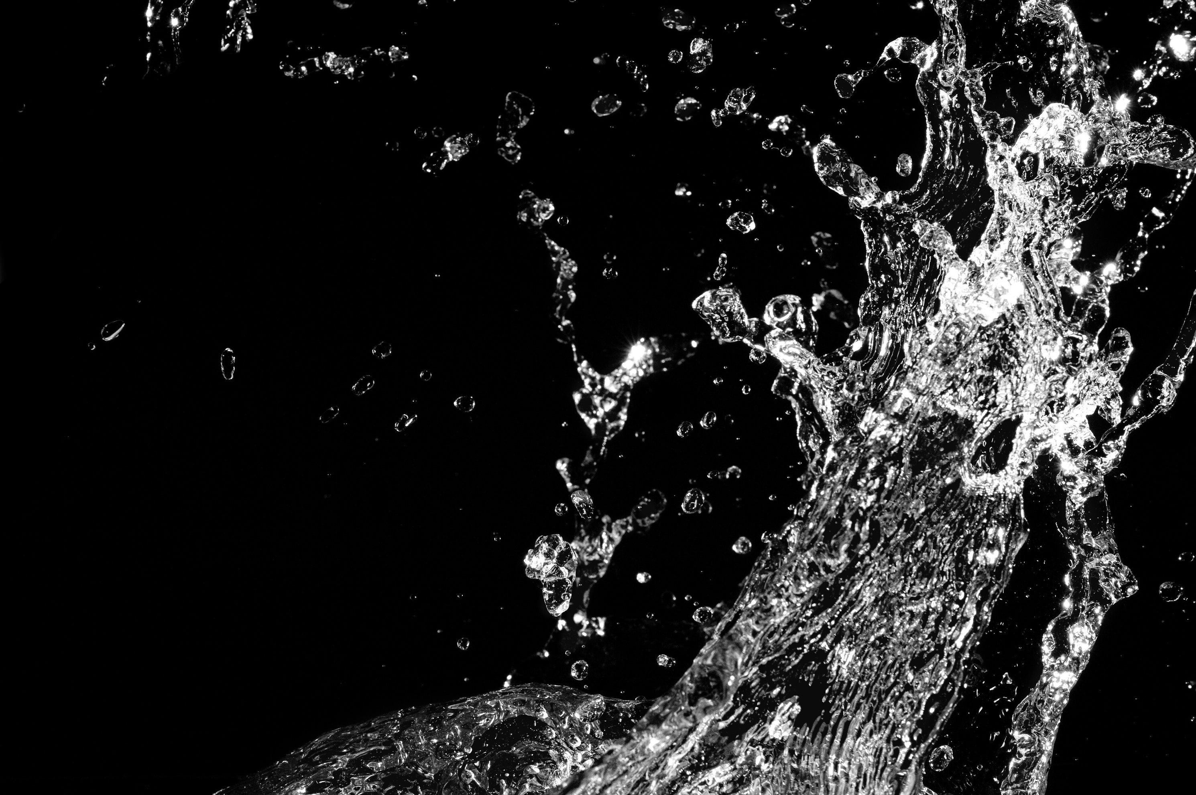

WHAT ARE WATER BASED INKS?
Water based inks are a stable dispersion in water of very small solid particles in a resinous vehicle and the action of surfactants and other performance additives.

Slide 3
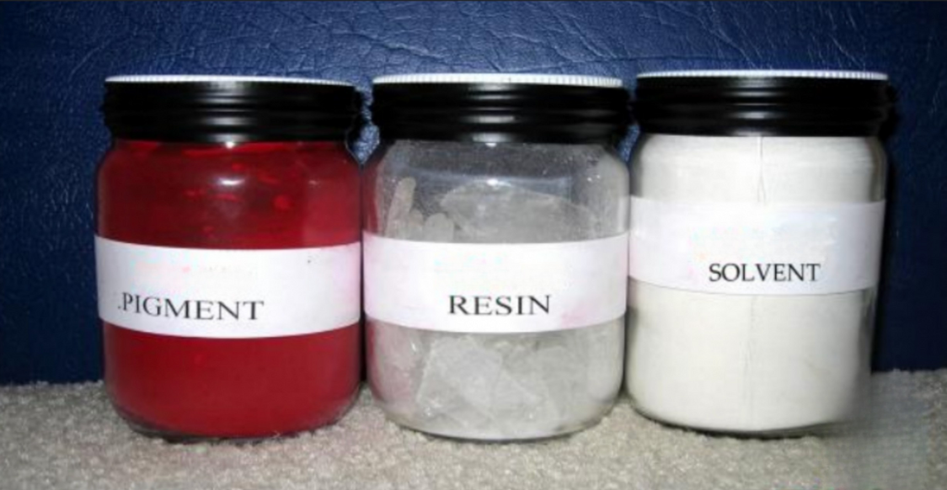
WHAT IS INK MADE OF?

Slide 4
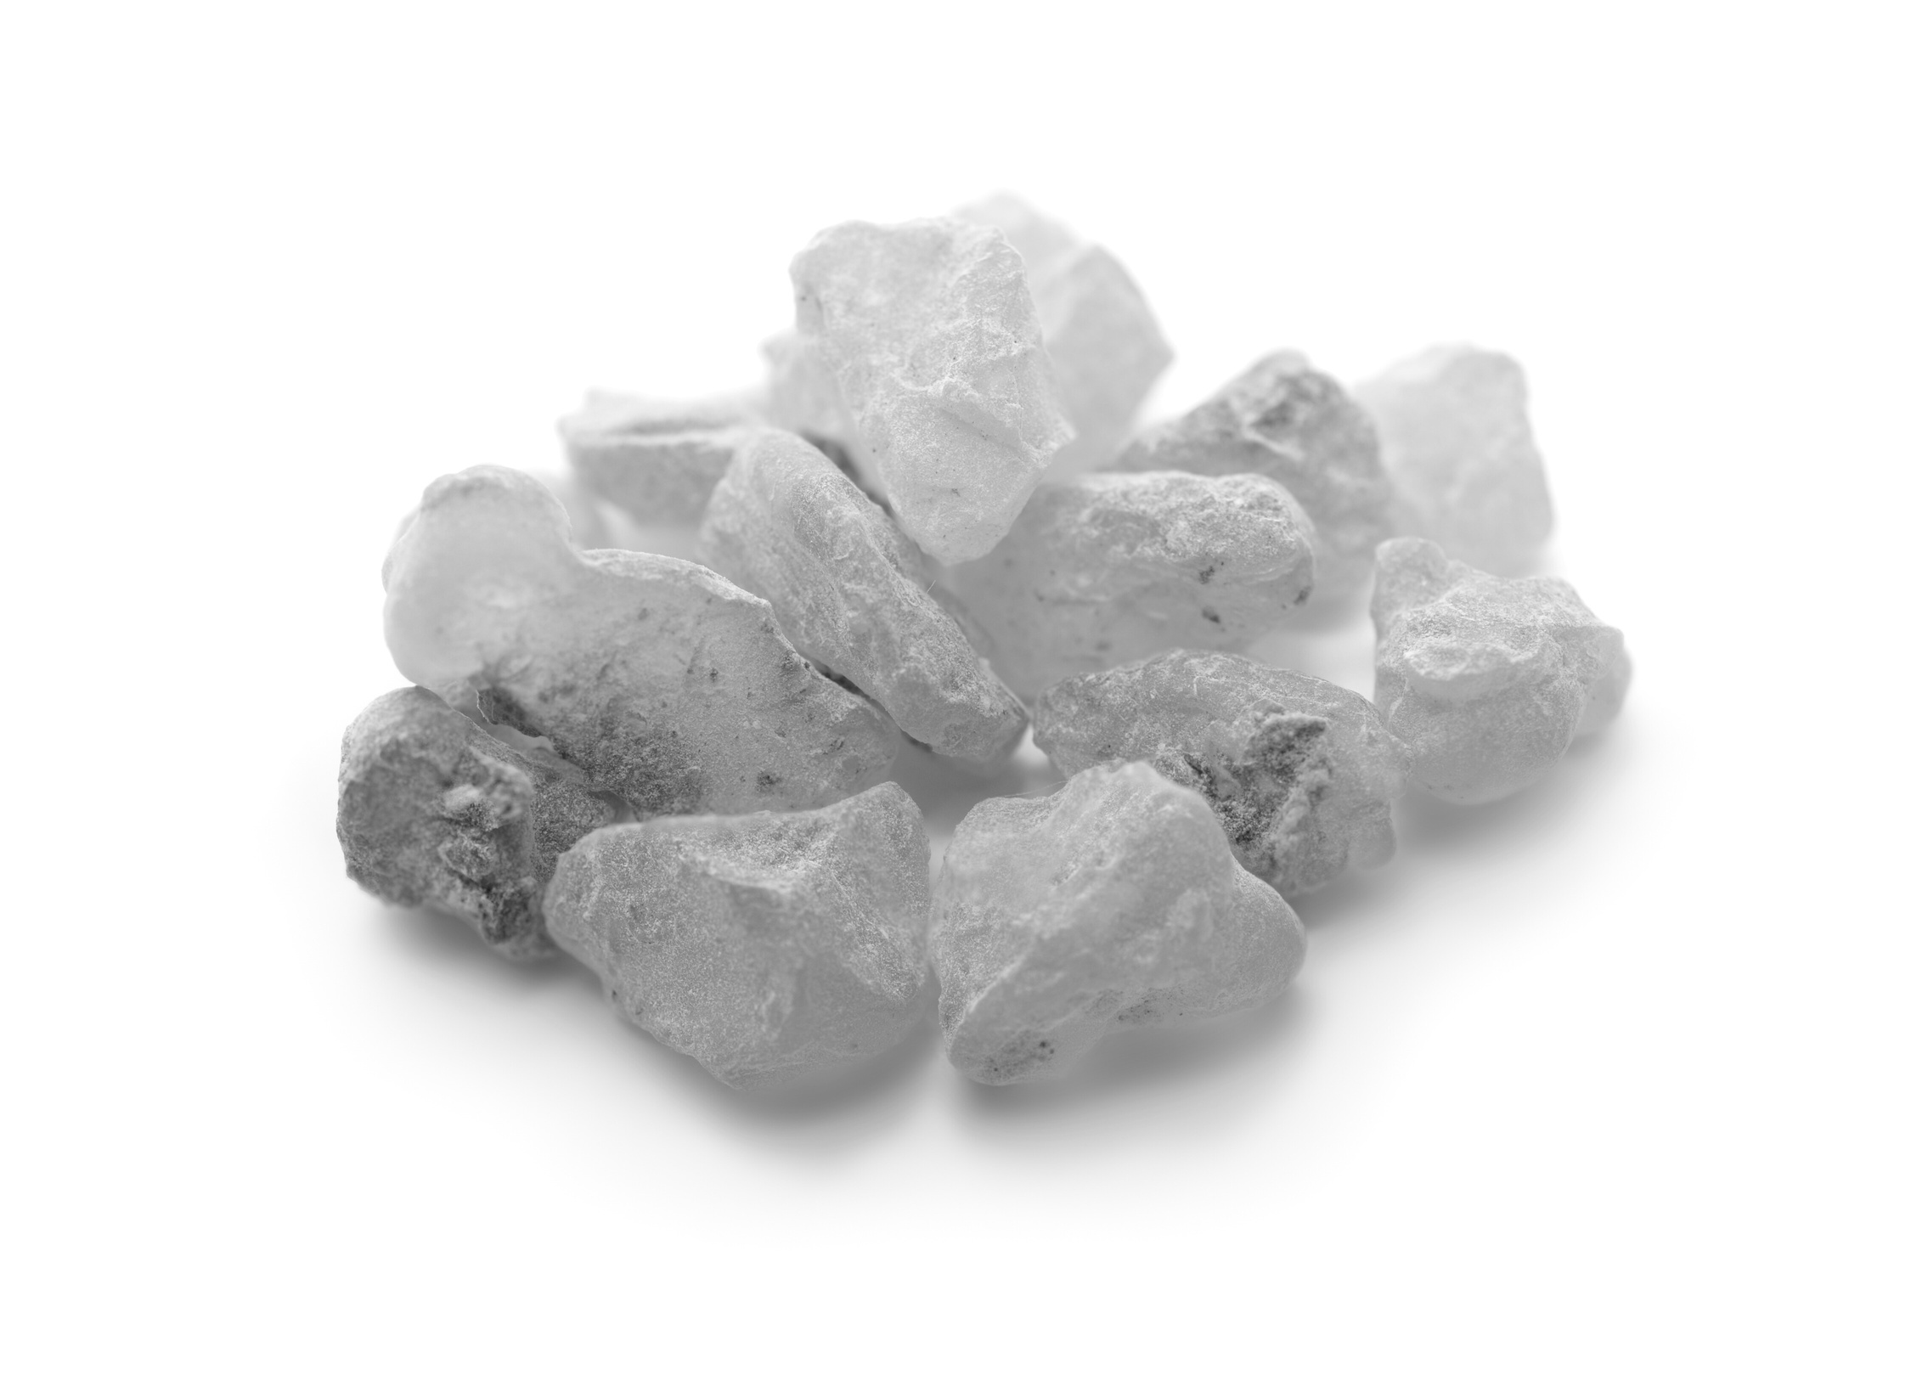
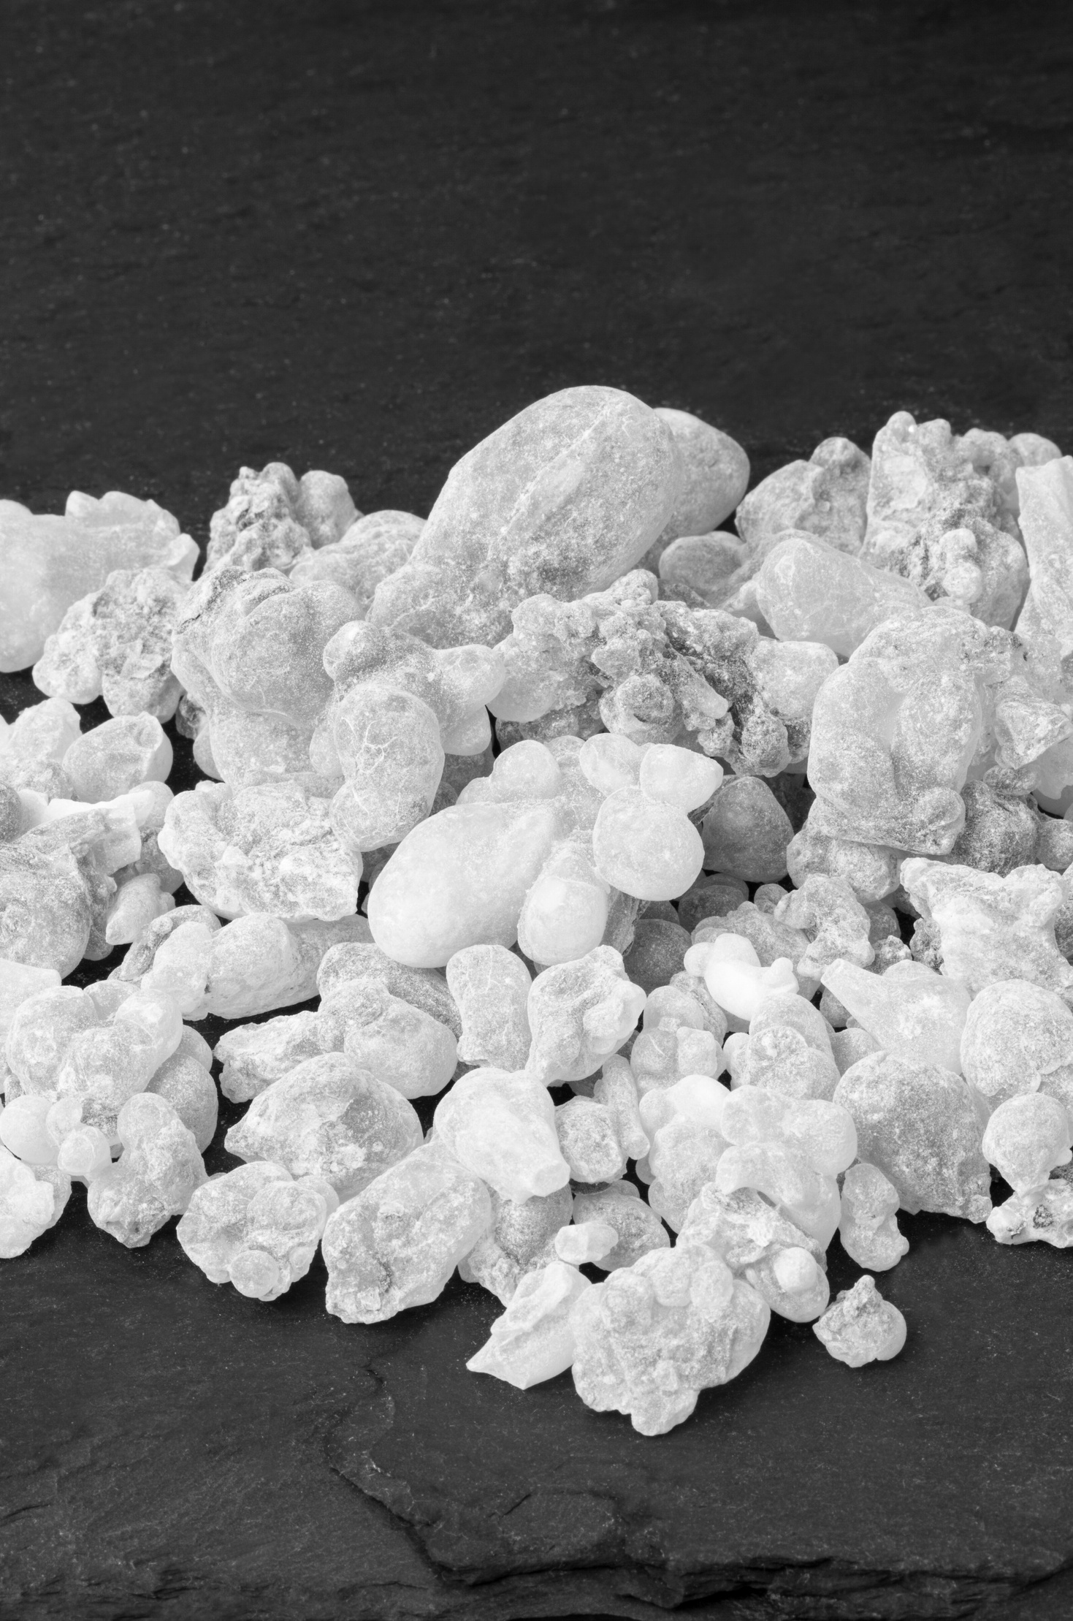
RESIN
VEHICLE OR EXTENDER
The system dictates the primary properties of a printing ink; product resistance, adhesion, printability, etc.
The vehicle or extender is how the pigment travels from inking system, anilox, and plate to the board.

Slide 5
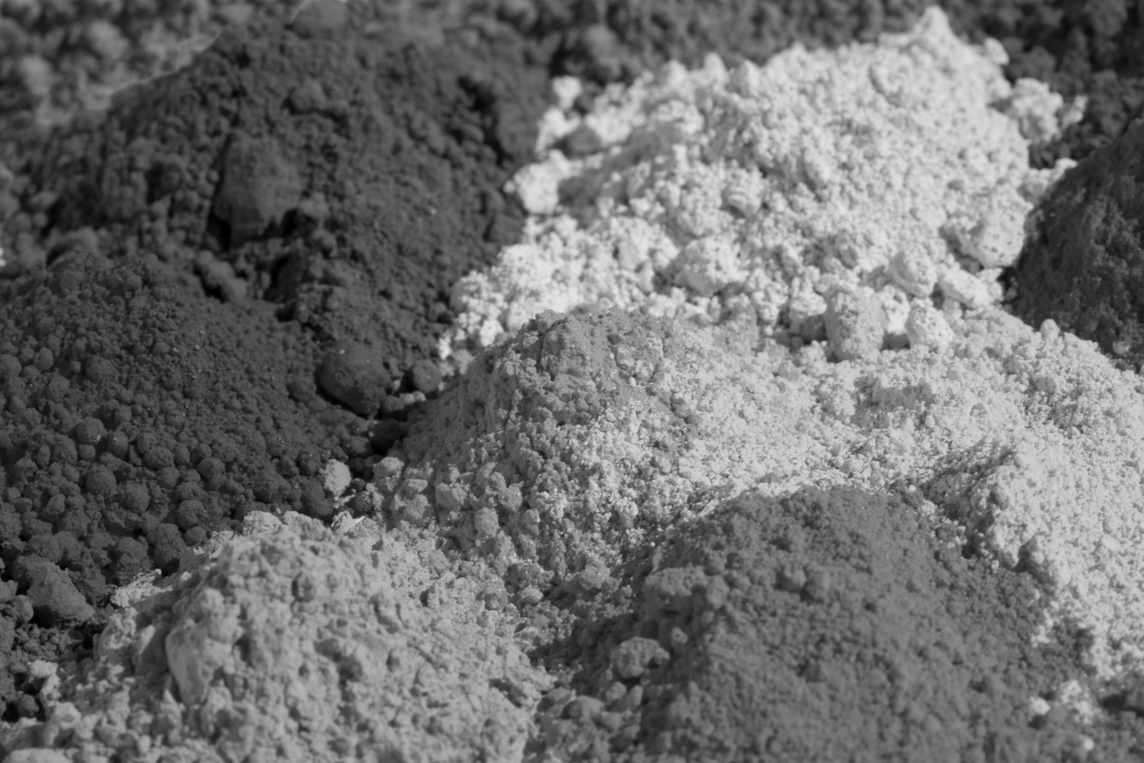
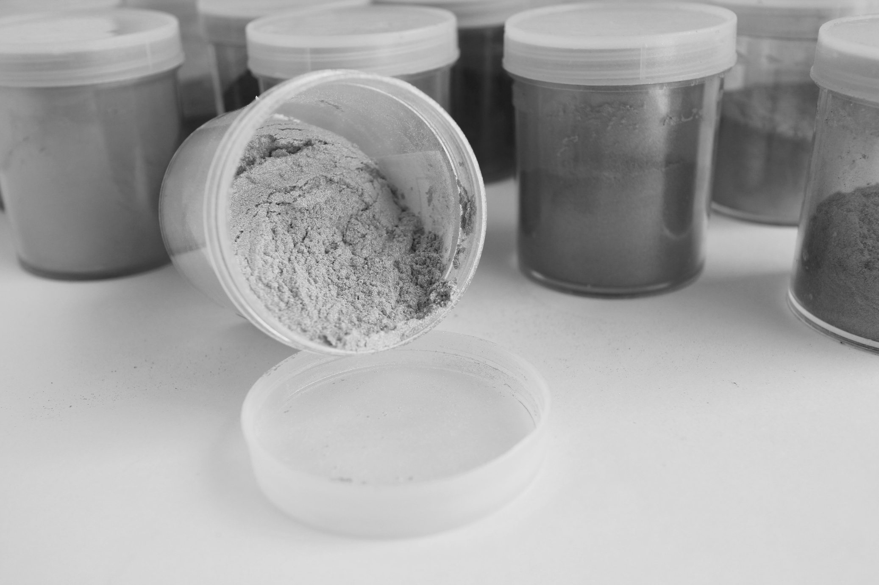
PIGMENT
Either dry powder or pre-dispersed into a solution. This is the colorant in an ink.
Typically, the most expensive raw material portion of a printing ink.
There are many different grades and shades of pigment.
GENERAL RULE
The more you want it to do, the more expensive the pigment thus the more expensive the ink will be.

Slide 6
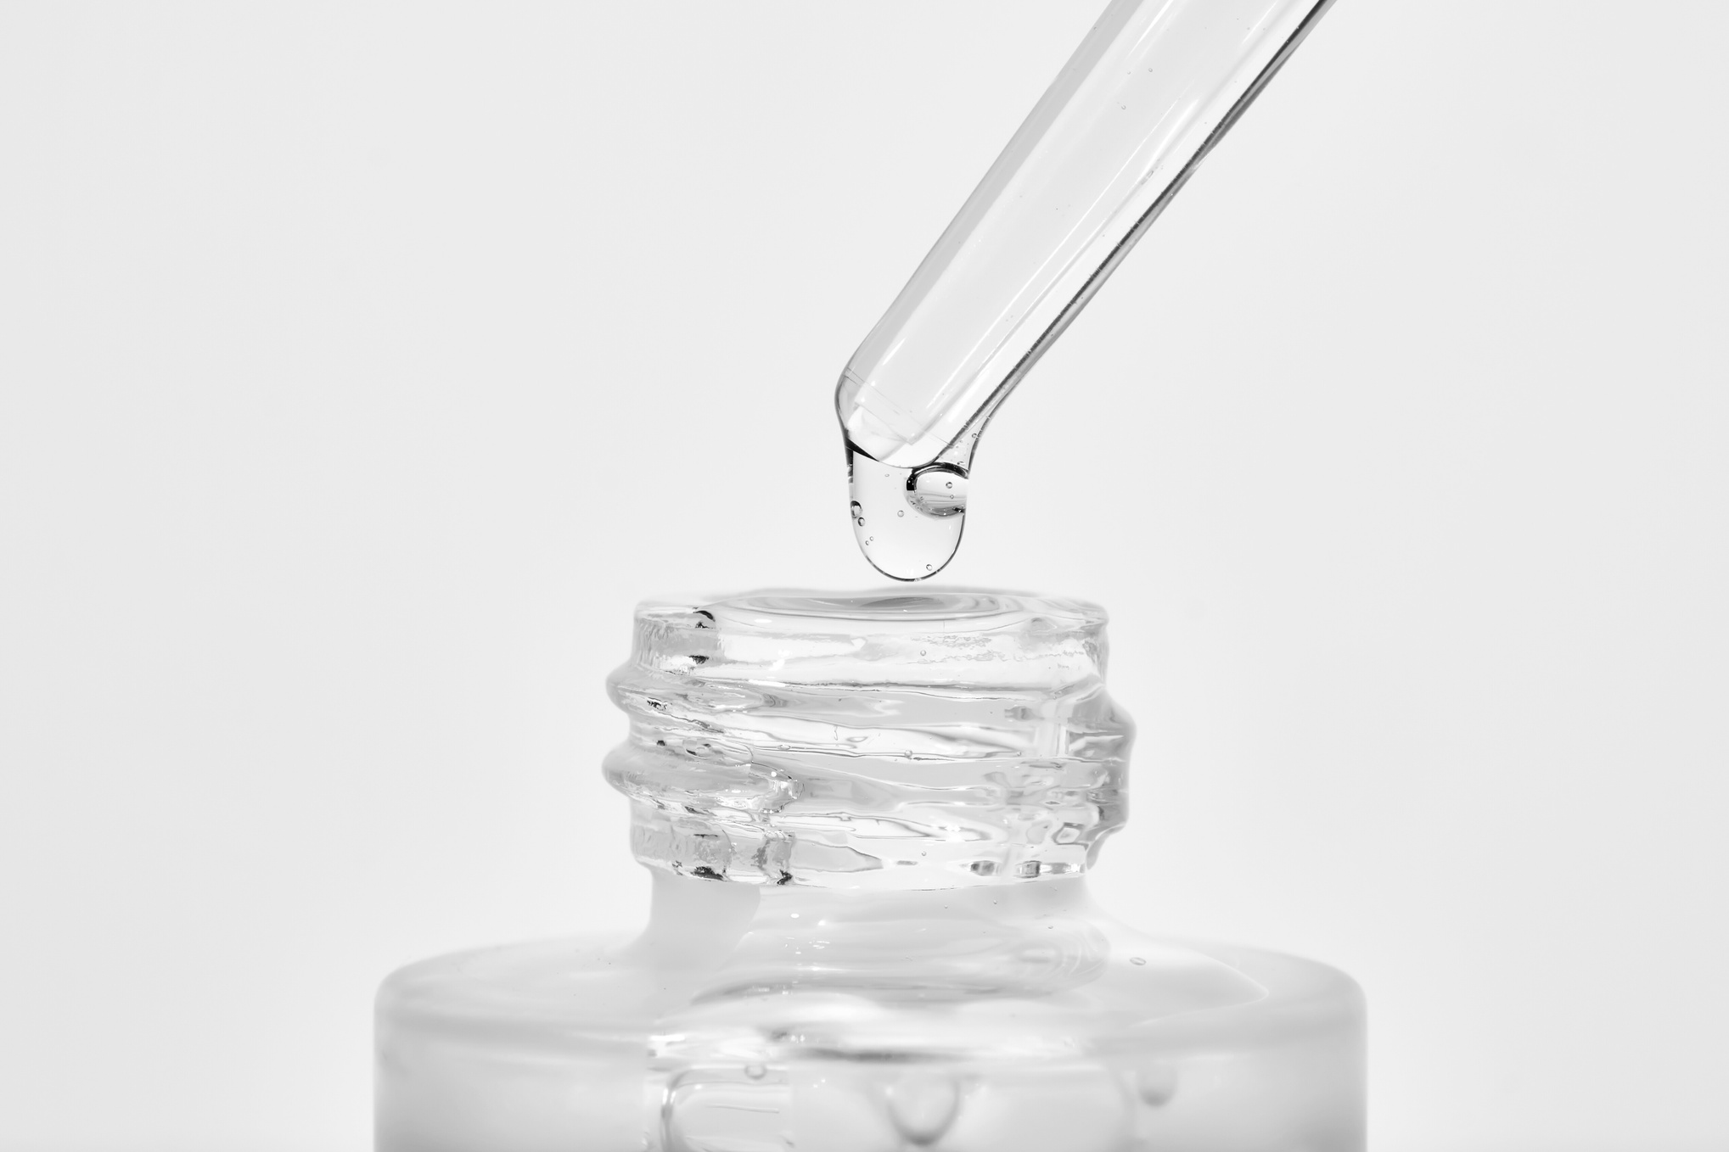
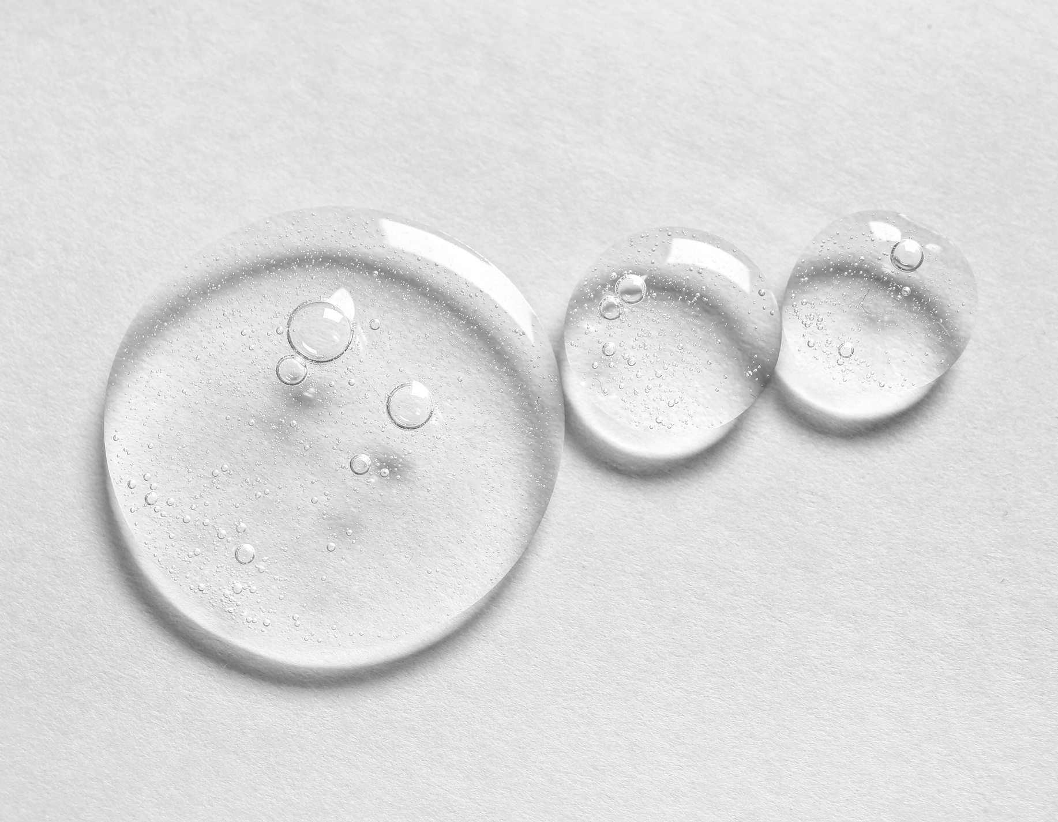
ADDITIVES
Waxes, transfer aids, defoamer, surfactants, silicone, etc. These are used to enhance the performance properties of an ink system.
Examples are improved rub resistance, printability, adhesion, etc.
More is not better!

Slide 7
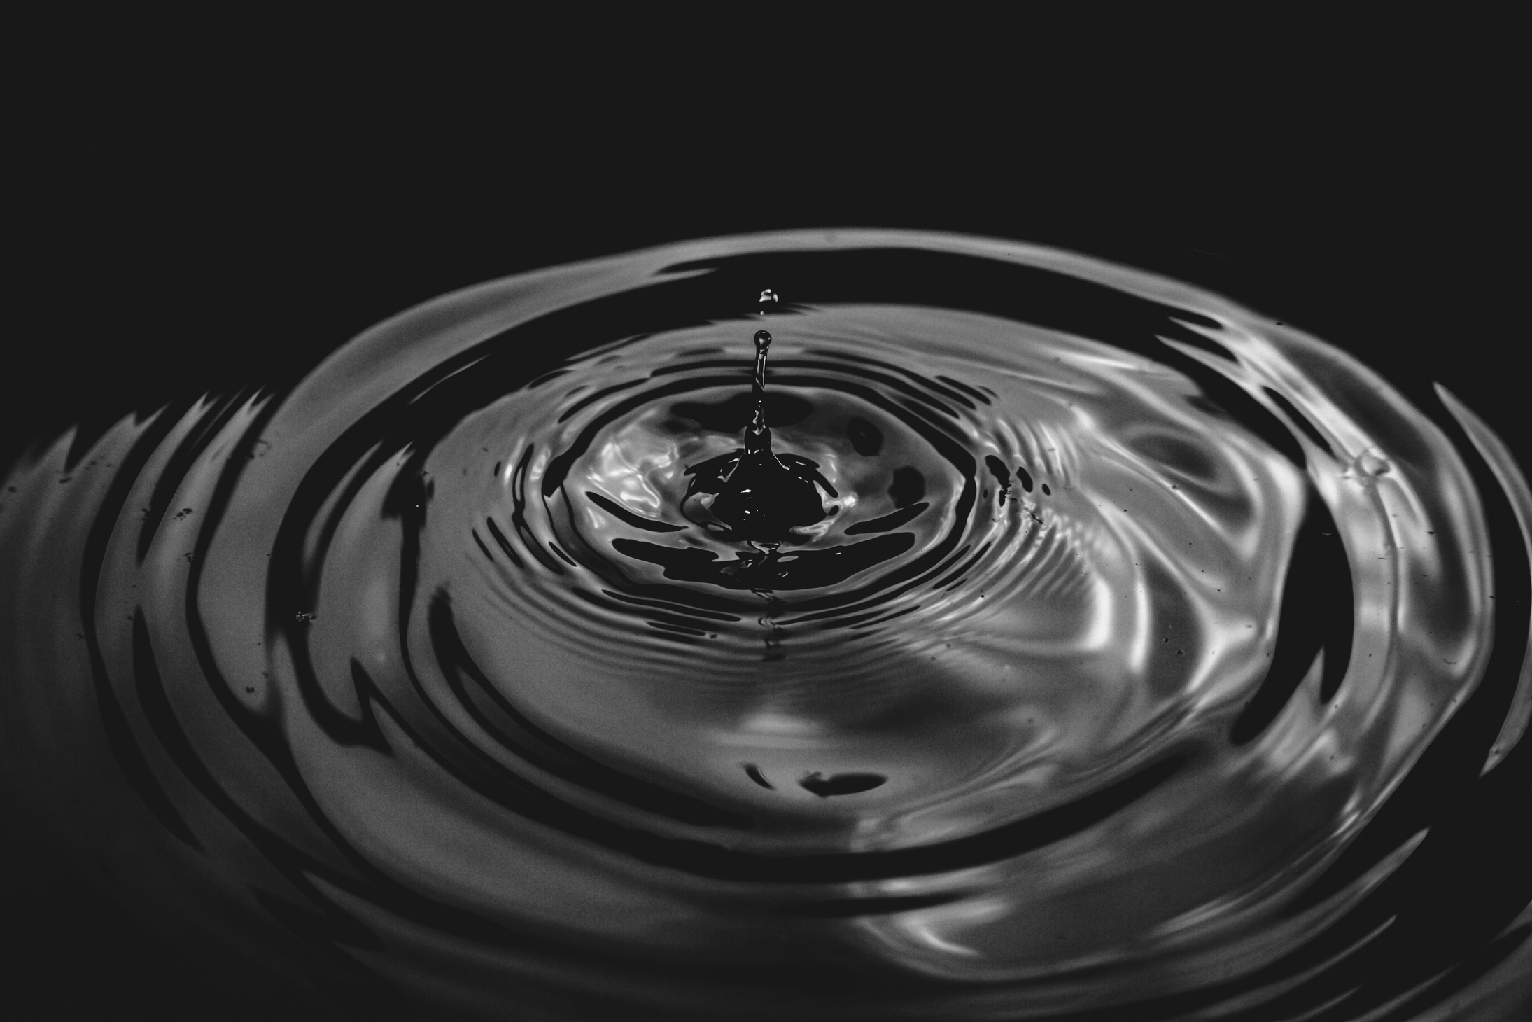
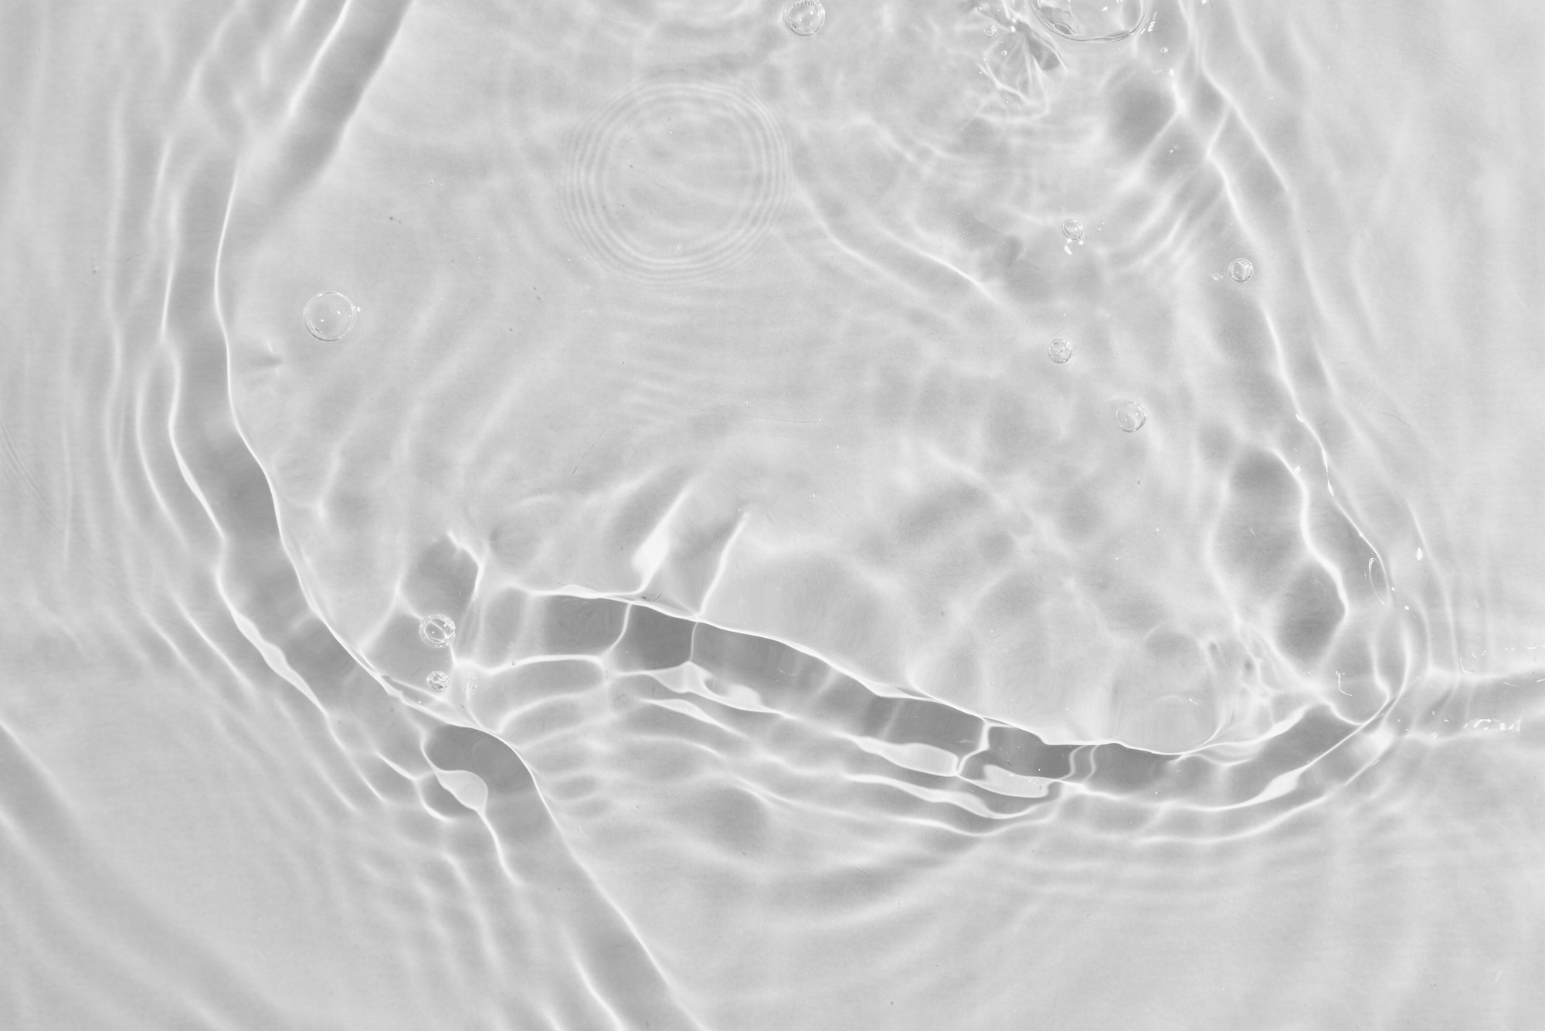
SOLVENTS & VOLATILES
In a water-based ink, water is the primary solvent, but alcohol can be used to accelerate the drying speed.
Water and amines, about 60% of a typical ink, providing solubility and re-solubility.

Slide 8
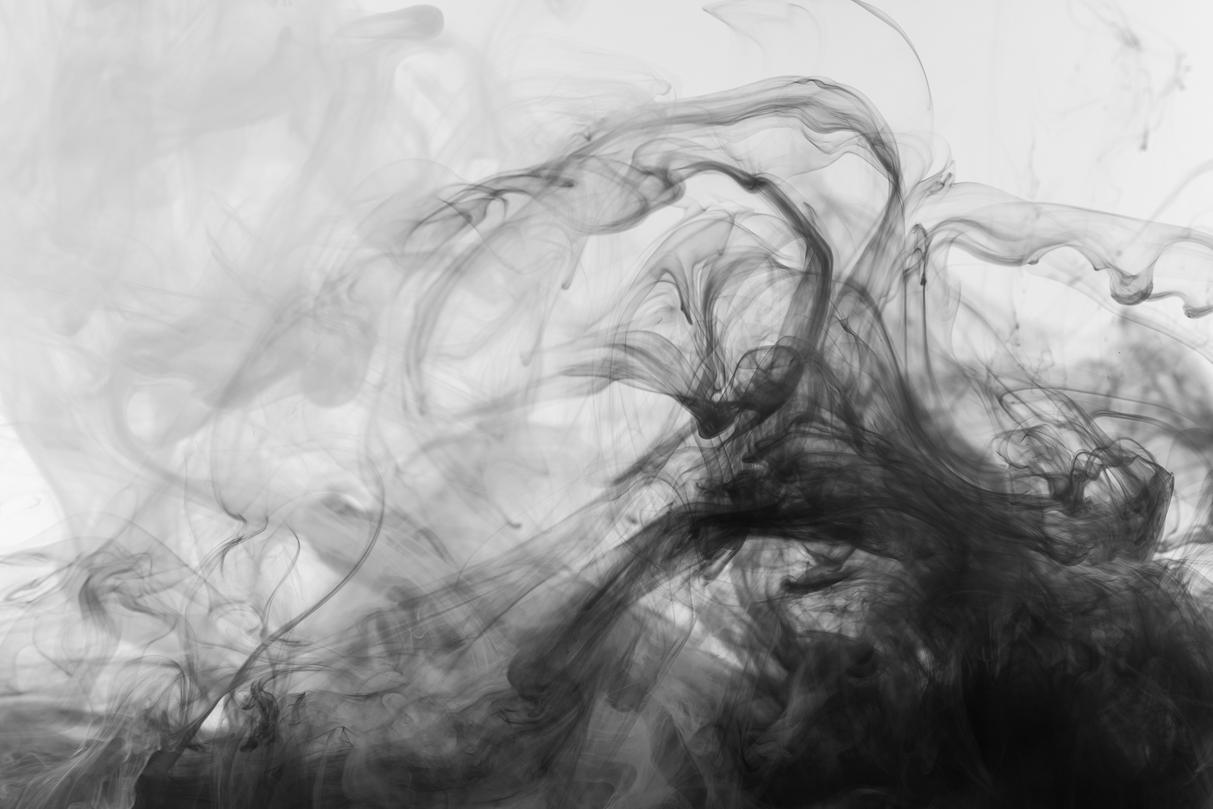


TYPICAL WATER BASED INK OR COATING
60%
40%
WATER
SOLIDS
Combinations of pigment, polymer, and/or filler.

Slide 9
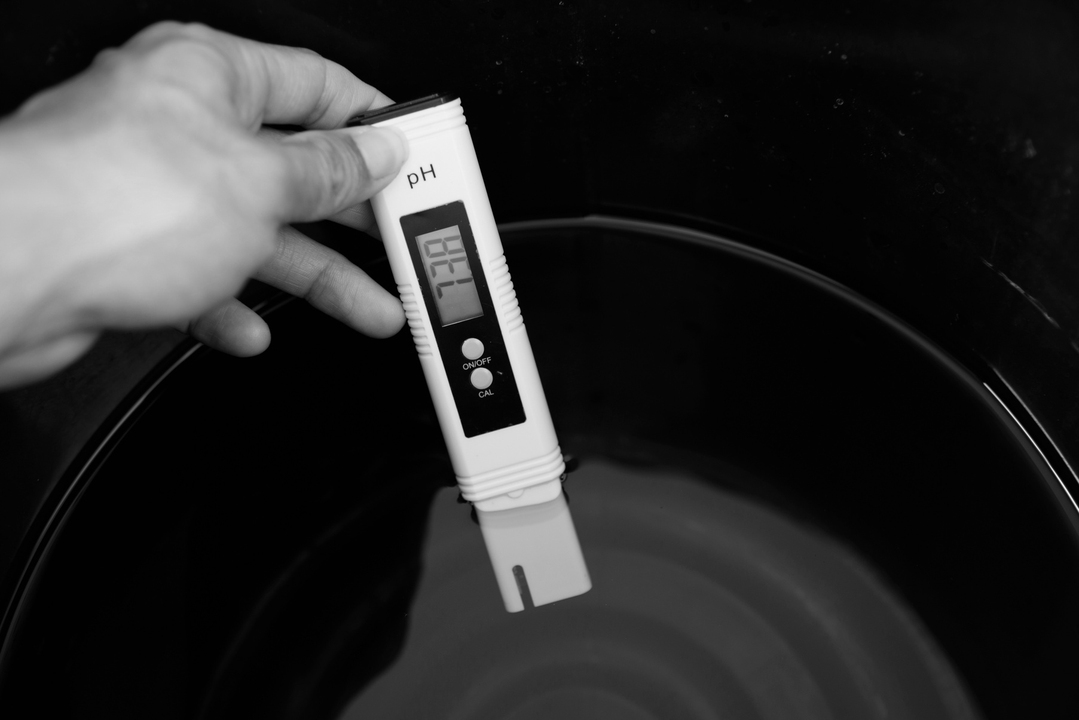
UNDERSTANDING
PH
8.5 - 9.5
Flexo Inks
0
Acid
7
Neutral
14
Alkaline
Vinegar
Soft Drinks
Soaps
Inks

Slide 10
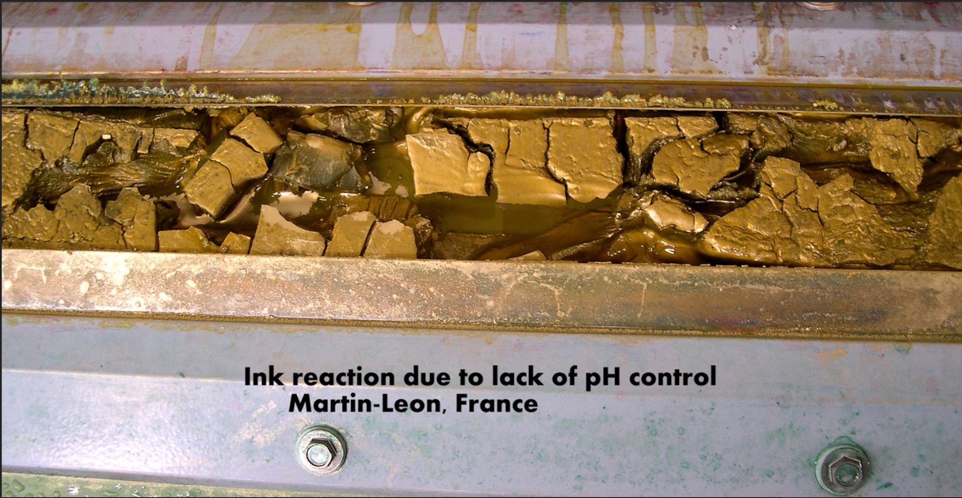
HOW CRITICAL IS PH CONTROL?

Slide 11
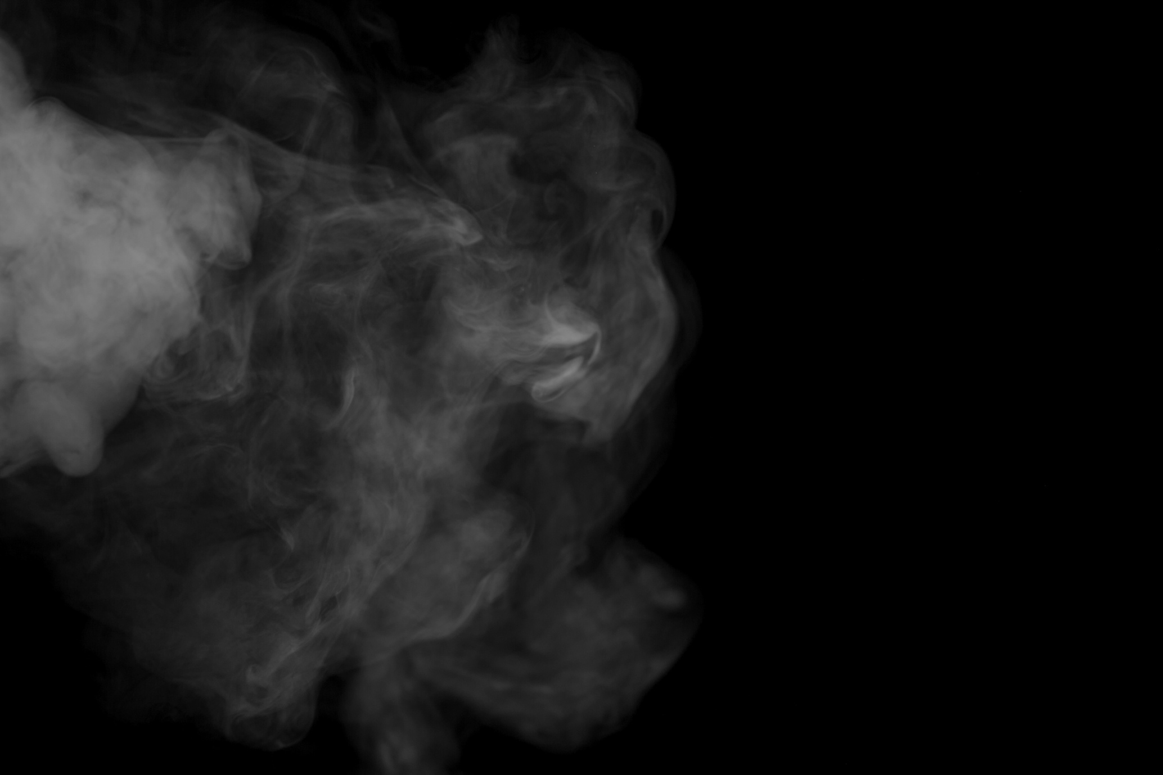
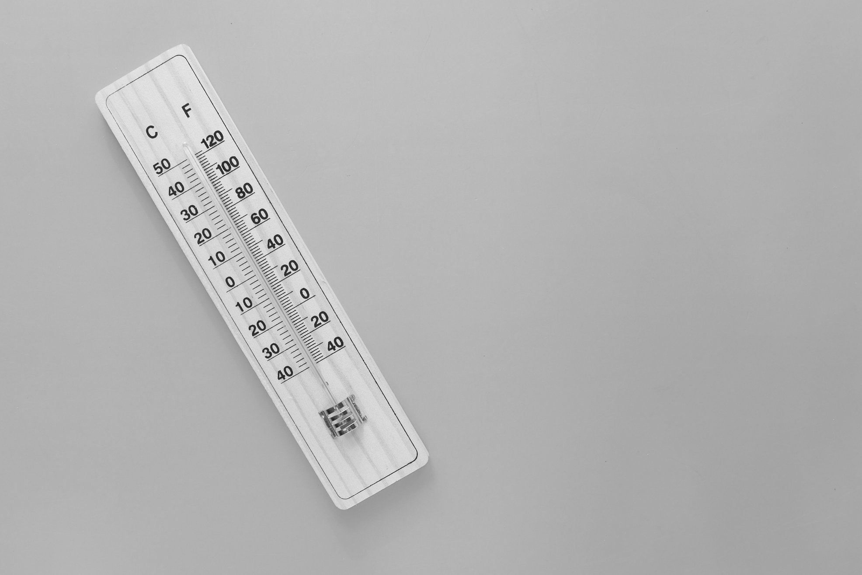
VARIABLES
IMPACTING PH
STABILITY
Pressroom Environment — heat and lack of humidity
Friction/heat from Doctor Blade Sheer
Over agitation of inks
Uncovered ink kits

Slide 12

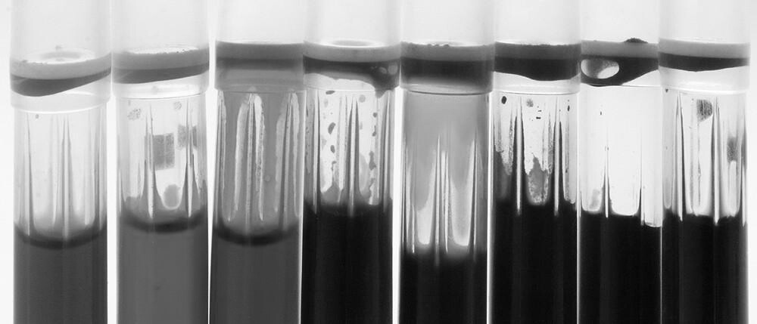
IMPACT OF LOW
PH (<8.8)
Dries too fast on anilox roller, plates, or linerboard
Less stable on press
Difficult to rewet on plate
Unstable color
Harder to clean up
Viscosity increases > resin can “kick out”

Slide 13
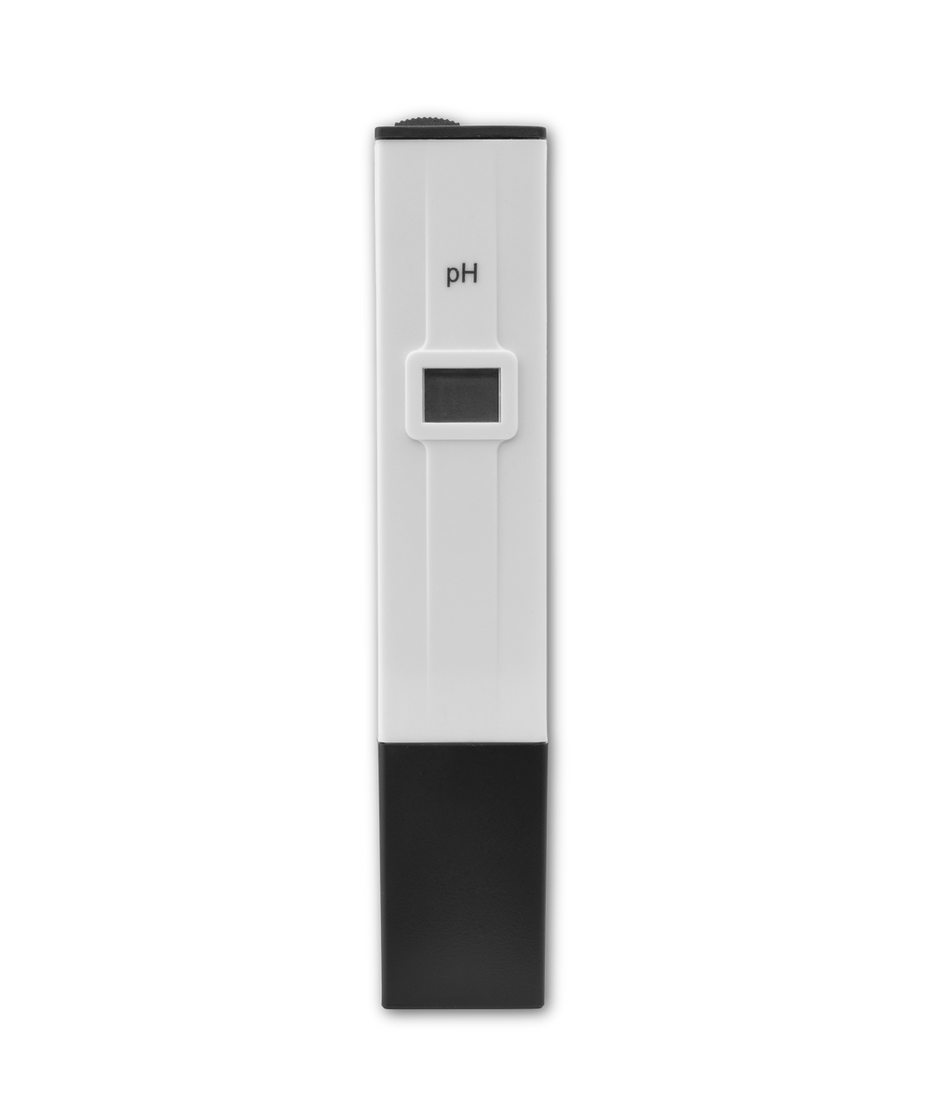
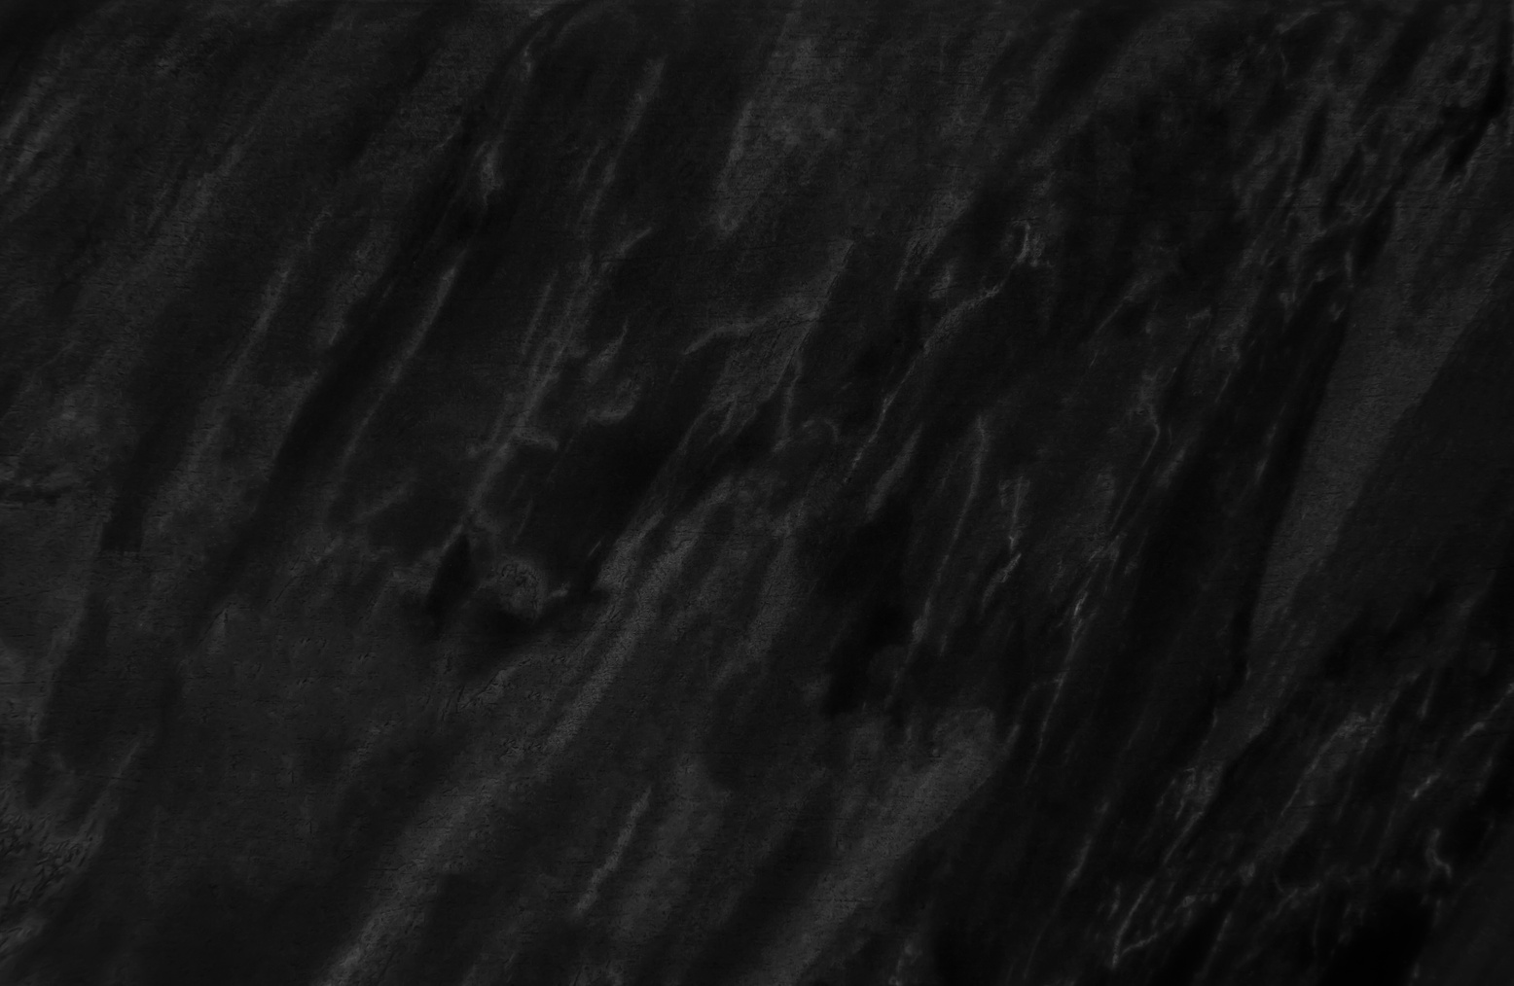
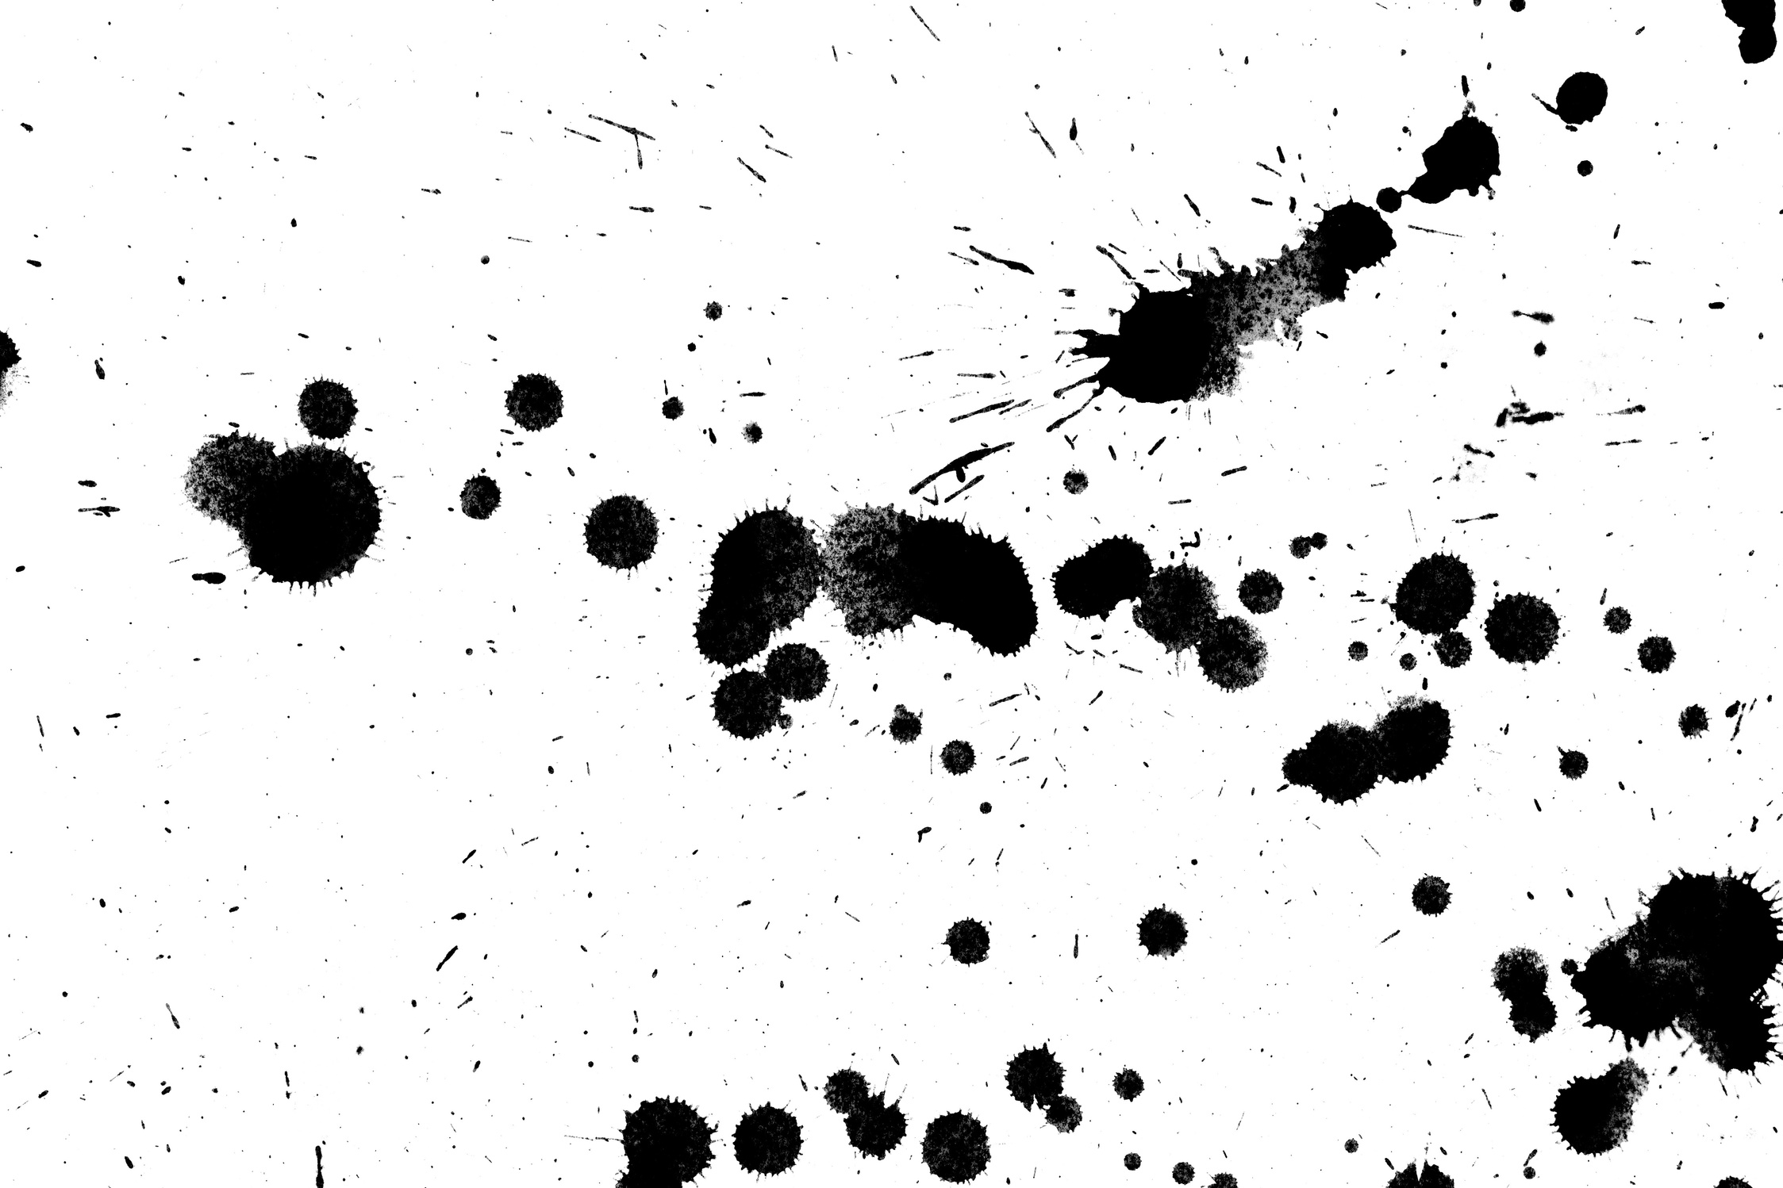
IMPACT OF HIGH
PH (<9.6)
Slower drying
Softer film
Color burnout
Viscosity decreases
Odor problems

Slide 14

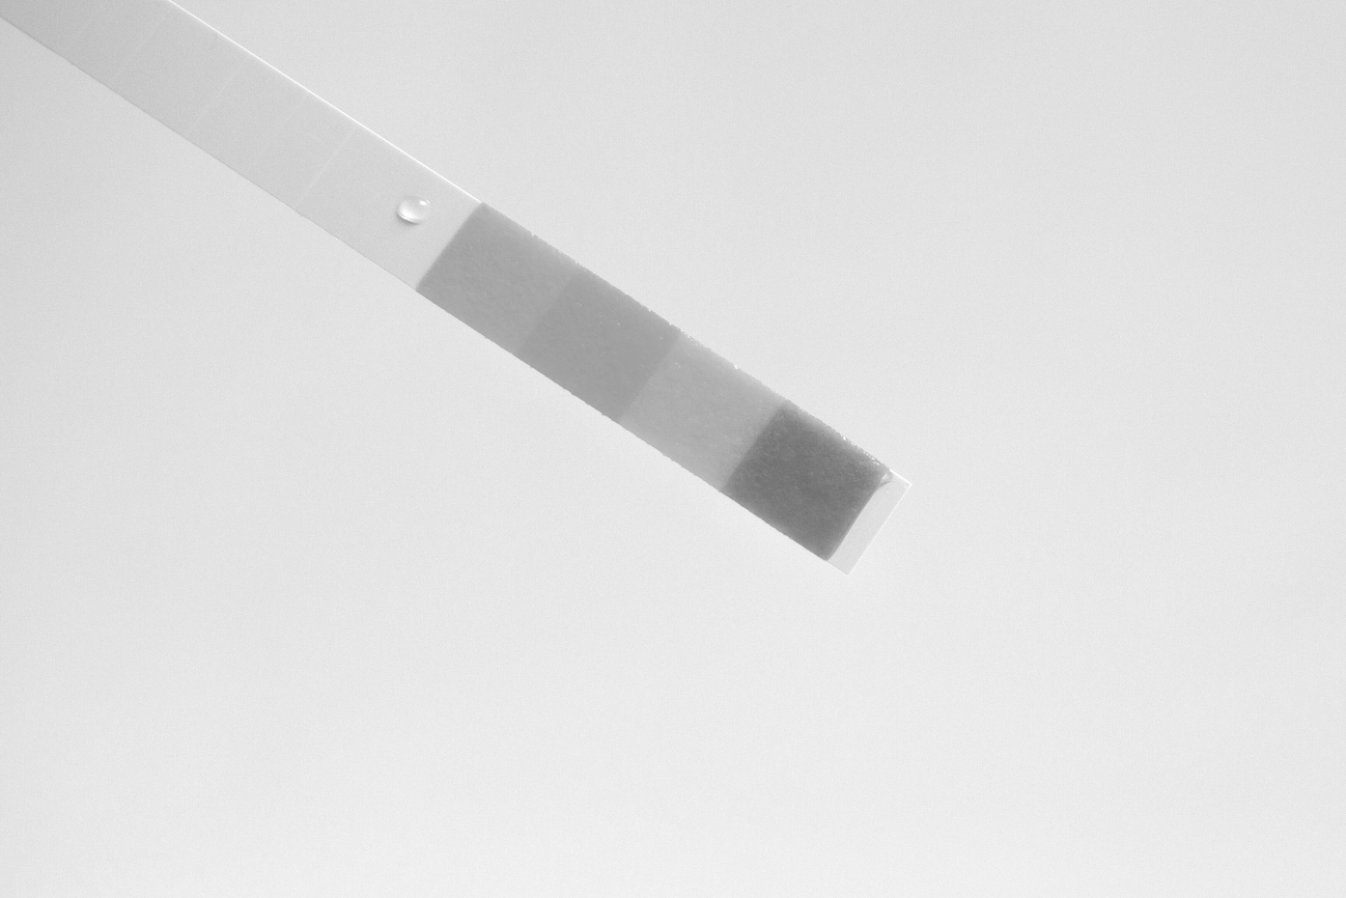
CORRECT PH
(8.8 - 9.6)
Good resolubility on plates & roller
Fewer stops to wash plates
Easy clean up
Stable viscosity
Stable color

Slide 15
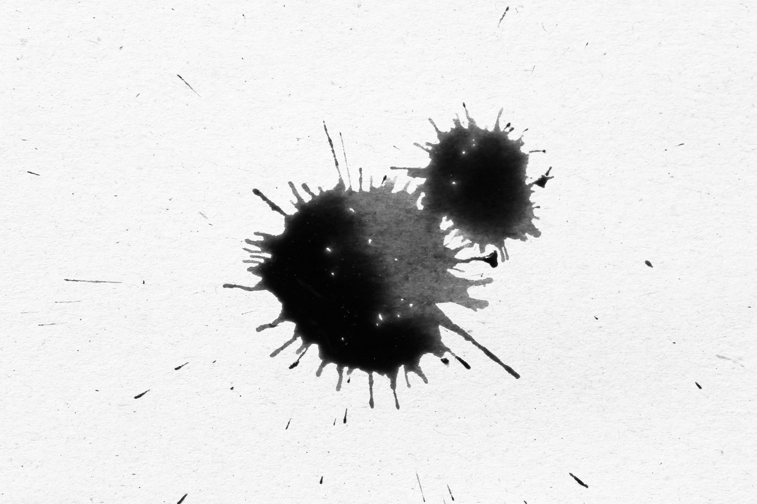

IF I TAKE CARE
OF MY PH...
Plate and anilox clean up is much easier
Ink on the shelf doesn’t come back as mud
Restore pH at the end of run as well as the beginning
All save time and money

Slide 16
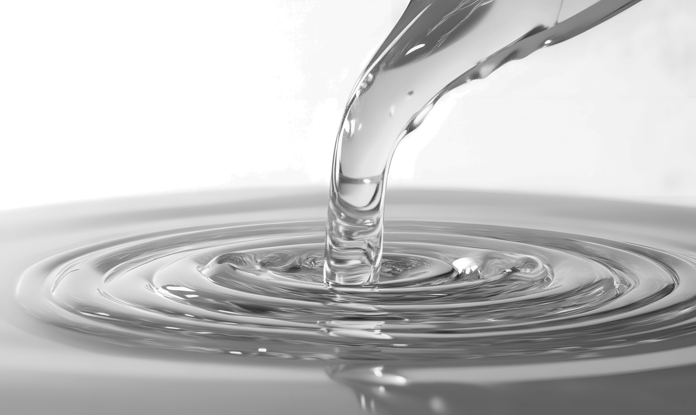
WHAT IS
VISCOSITY?
A measure of a liquid’s ability to resist flow
The higher the viscosity, the less easily it will flow
An inks’ pH influences its viscosity

Slide 17
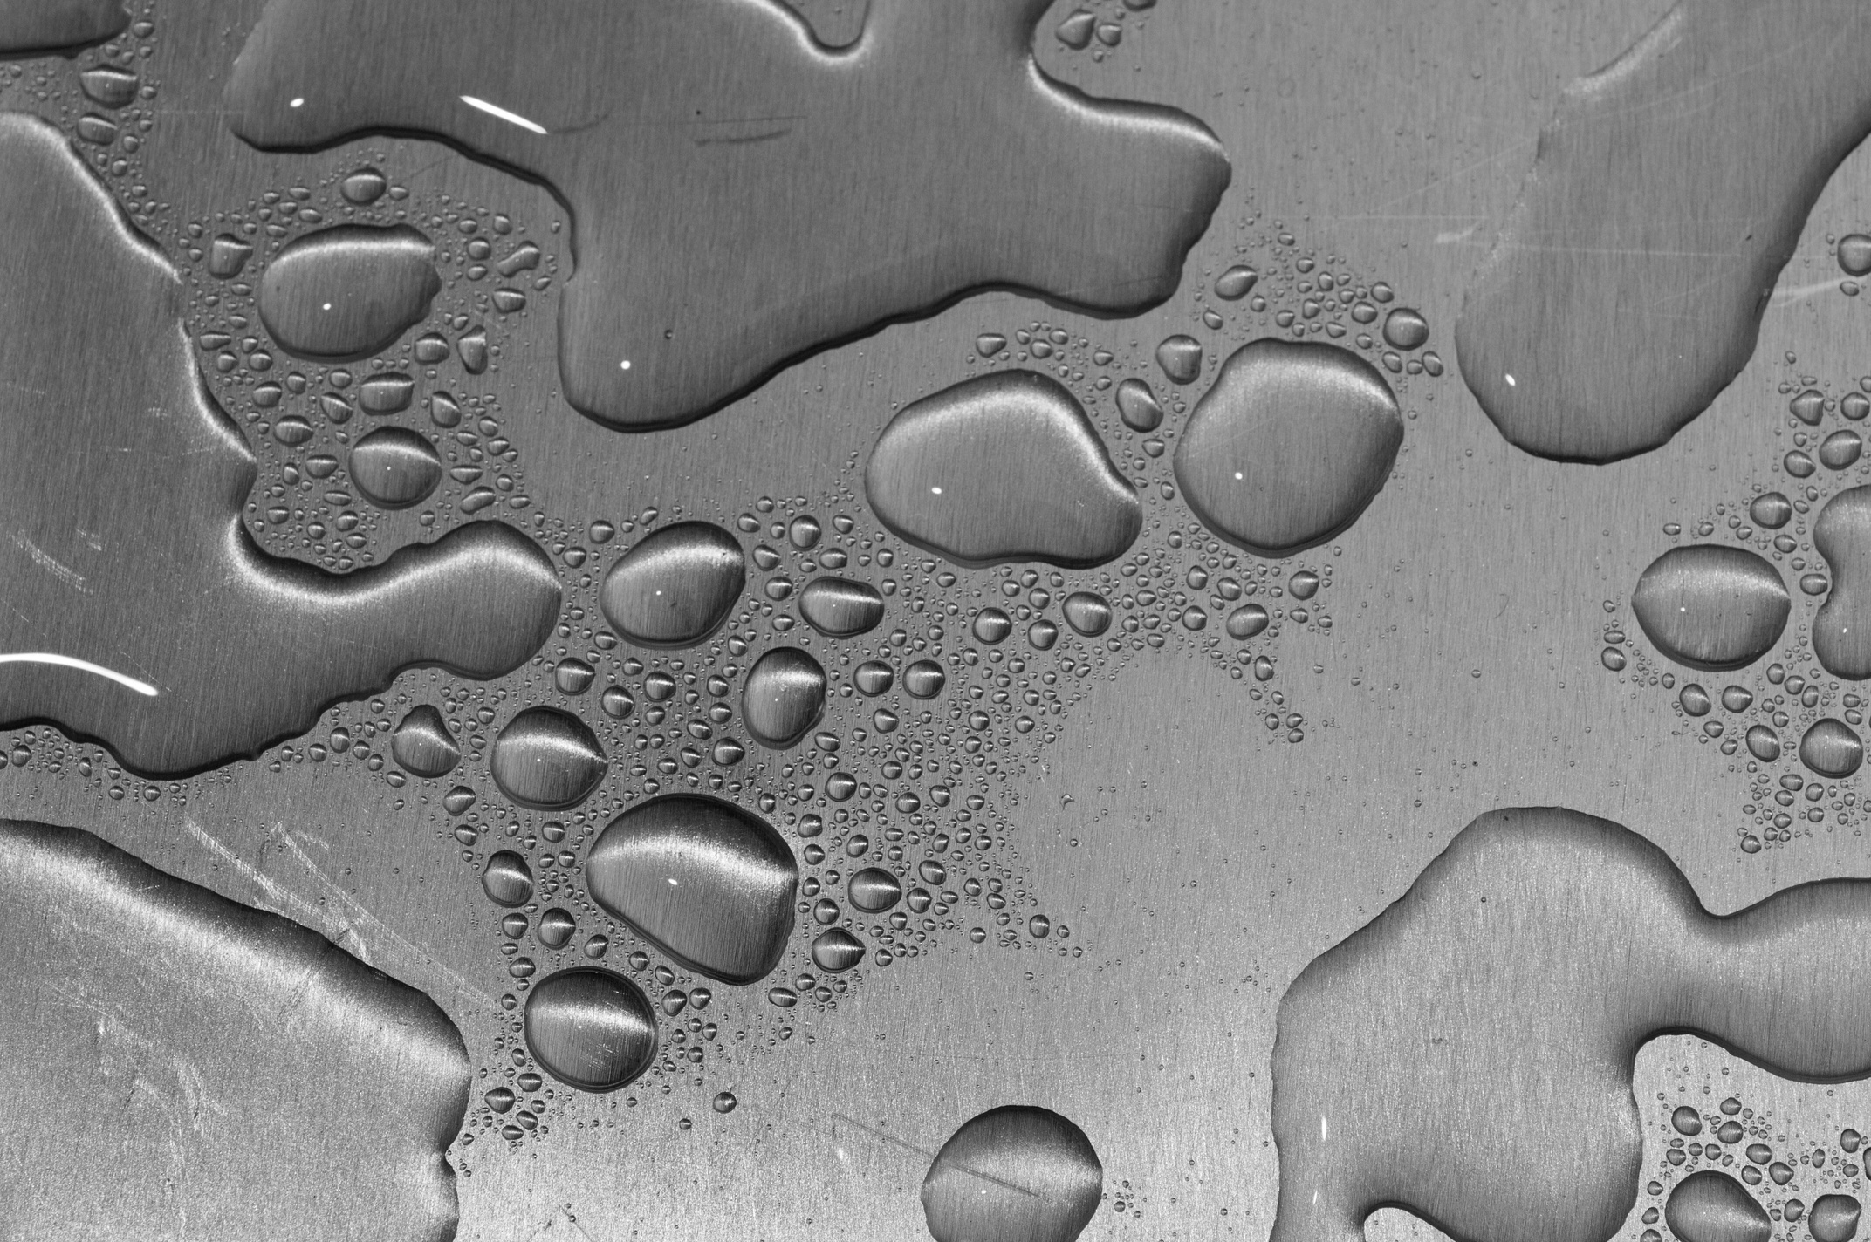
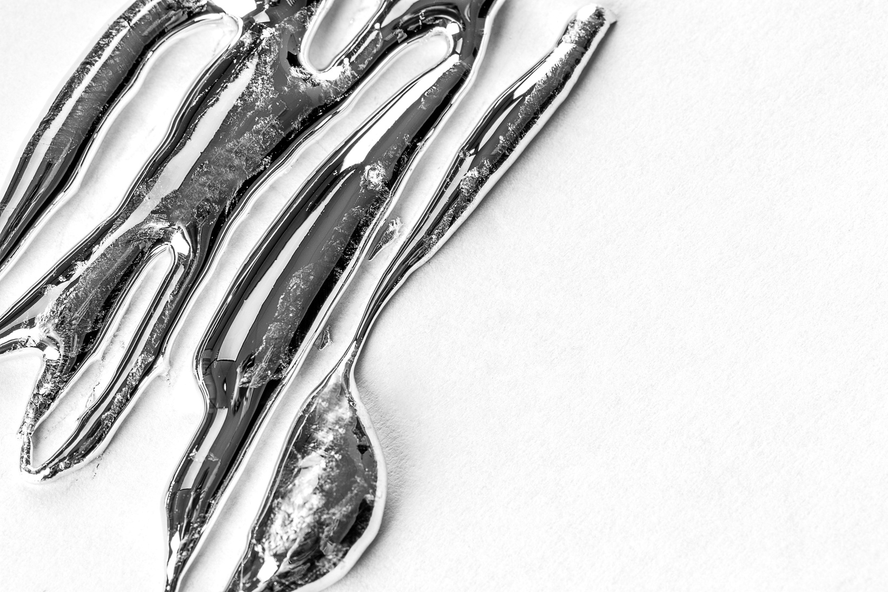
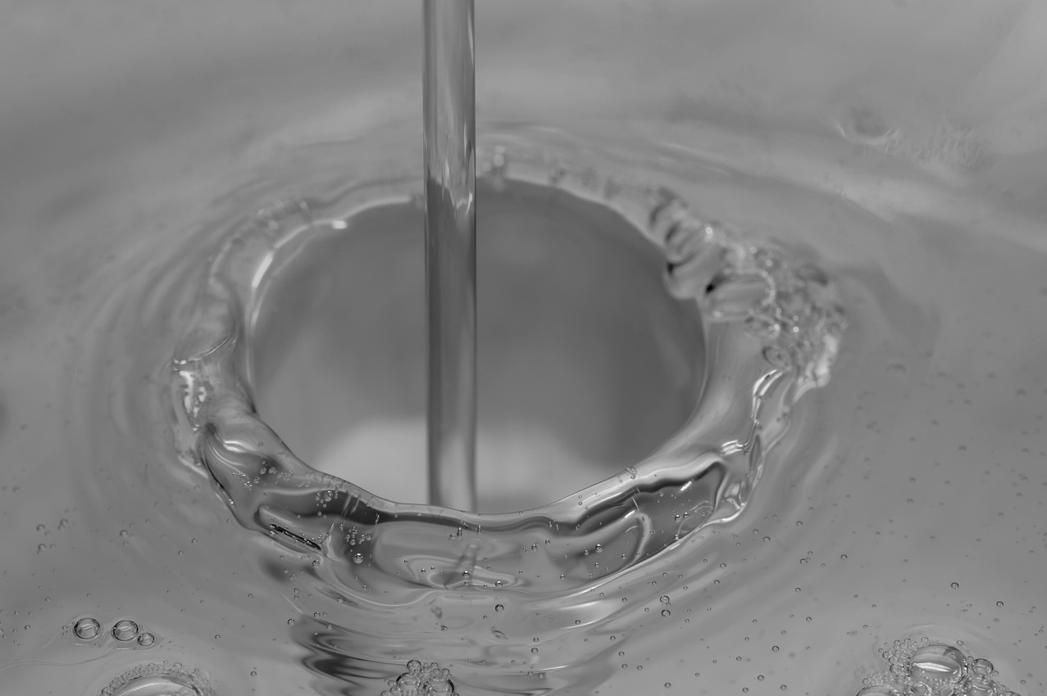
HIGH VS LOW VICOSITY
The running viscosity affects the amount of ink that is transferred to the stock.
HIGH
LOW
Excess Ink Transfer
Tracking
Smudging
Slow Drying
Weaker Print
Dries Too Fast
Foaming
Poor Coverage

Slide 18
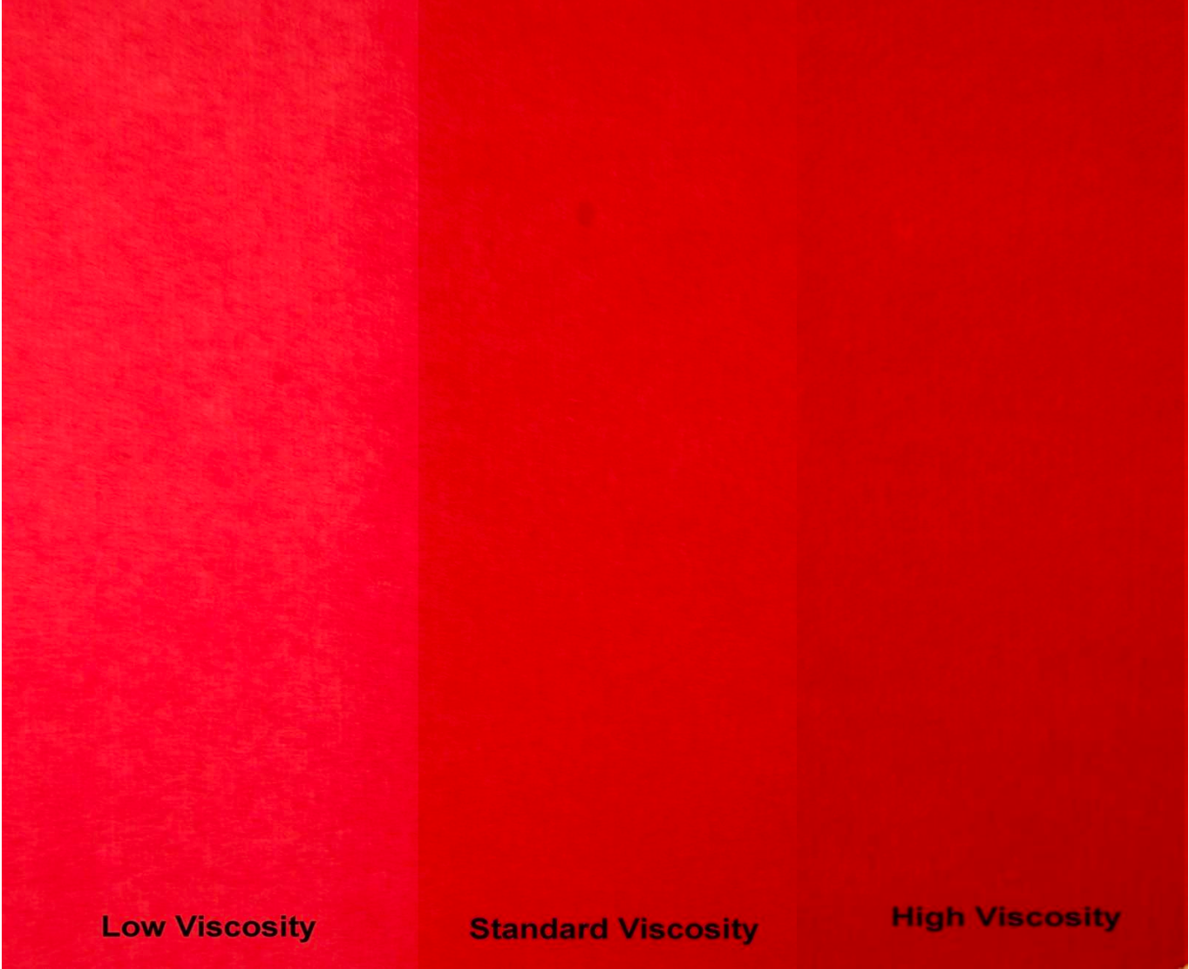
HOW DOES VISCOSITY IMPACT COLOR?
LOW VISCOSITY
STANDARD VISCOSITY
HIGH VISCOSITY

Slide 19
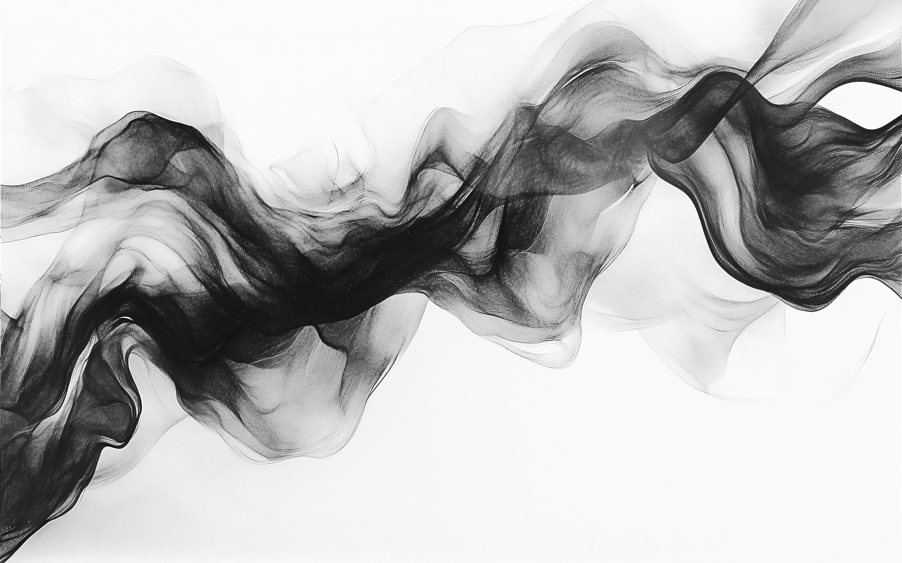
BEST PRACTICES
DOCUMENT PH AND VISCOSITY CHECKS:
Check / restore pH and viscosity before starting a new job.
Check the pH and viscosity every 30 minutes throughout the run
Restore the pH at the end of the run

Slide 20
DON’T LET YOU
INK ENTER THE
DANGER ZONE
Keep your inks pH away from both the lower and higher end of the acceptable range:
8.8 - 9.6

Slide 21
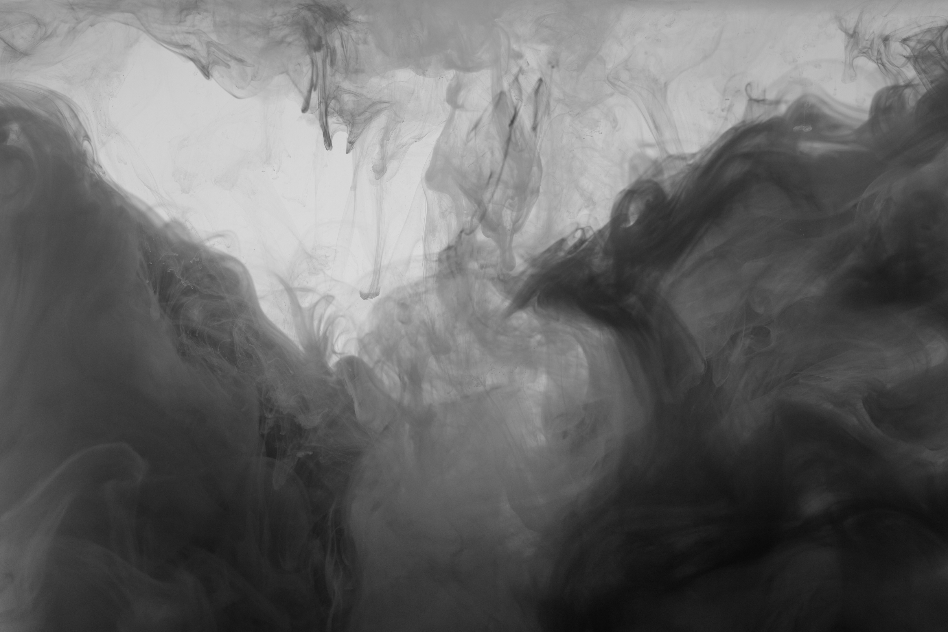
QUESTIONS?
JAKE WANDREY
Operations Manager | J.M. Fry Inks
jake.wandrey@jmfryinks.com
(870) 941-1509

